Slide 1
Preoperative physiotherapy for the prevention of respiratory complications after upper abdominal surgery
R1สุพฤกษ์ / อ.วิริยะ

Slide 2
Introduction
A postoperative pulmonary complication (PPC) is the most common serious complication after upper abdominal surgery
Incidence is between 10% and 50% of patients
Notes:
The variability in reported PPC rates after upper abdominal surgery can be explained by the differing patient risk profiles studied and PPC definitions utilised

Slide 3
Introduction
PPC is strongly associated with increased mortality, morbidity, and healthcare costs
Breathing exercises may prevent PPCs by reversing these problems
The time point of initiation of breathing exercises could be improved if patients were trained to perform their breathing exercises immediately after surgery

Slide 4
Introduction
Preoperative education and breathing exercise training alone is reported to be associated with
75% relative risk reduction
20% absolute risk reduction
Notes:
although this effect could be exaggerated by methodological biases of single centre trials, non-masked assessors, and low risk surgical cohorts

Slide 5
Introduction
The Lung Infection Prevention Post Surgery Major Abdominal with Pre-Operative Physiotherapy (LIPPSMAck-POP) trial
preoperative education and breathing exercise training delivered within six weeks of surgery by physiotherapists reduces the incidence of PPCs after upper abdominal surgery

Slide 6
Introduction
This study tested this pragmatically with physiotherapists of varying levels of experience providing the intervention within existing multidisciplinary preadmission clinics and within the context of modern advances in perioperative management

Slide 7
Methods
Pragmatic, international, multicentre, patient and assessor blinded, parallel group, randomised placebo controlled trial
Three Australian and New Zealand public hospitals
Site institutional review boards and ethics committees approved the study

Slide 8
Methods
Participants
Inclusion criteria
English speaking adults 18 years or older who were awaiting elective upper abdominal surgery that required general anaesthesia
A minimum overnight hospital stay
5 cm or longer incision above, or extending above, the umbilicus
Attended an outpatient preadmission assessment clinic

Slide 9
Methods
Participants
Exclusion criteria
current hospital inpatients
required organ transplants
required abdominal hernia repairs
unable to ambulate for more than one minute
unable to participate in a single physiotherapy preoperative session within six weeks of surgery

Slide 10
Methods
Randomisation
sequentially numbered sealed opaque envelopes containing allocation cards wrapped in aluminium foil
Intervention group=information booklet + preoperative physiotherapy education and training
Control group = information booklet alone

Slide 11
Methods
Randomisation
Randomisation occurred before the preoperative physiotherapy assessment
Web based computer generated blocked random number table (1:1)

Slide 12
Methods
Masking
Site investigators and preoperative physiotherapists aware of group allocation had no contact with patients postoperatively
The patients, postoperative physiotherapists, hospital staff, and statisticians were unaware of group assignment
Primary and secondary outcome assessors were masked to group allocation and not involved in postoperative clinical management
Notes:
We assessed the success of patient masking in a convenience sample of 29 consecutive participants

Slide 13
Methods
Interventions and procedures
patients are required to attend a hospital multidisciplinary outpatient clinic for presurgical evaluation within six weeks of surgery
The preadmission physiotherapy session for control and intervention participants consisted of a standardised physical and subjective assessment
Notes:
At these clinics patients are seen by a nurse, anaesthetist, doctor, and, if required, a stomal therapist. Consenting eligible patients were entered into the trial and provided with an additional physiotherapy session at these clinics.

Slide 14
Methods
Interventions and procedures
The physiotherapist gave an information booklet containing written and pictorial information about PPCs and potential prevention with early ambulation and breathing exercises
Breathing exercises were consisted of two sets of 10 slow deep breaths followed by three coughs, to be performed hourly and starting immediately after surgery

Slide 15
Methods
Interventions and procedures
Intervention group received an additional single 30 minute education and breathing exercise coaching session immediately after the standardised physiotherapy assessment

Slide 16
Methods
Interventions and procedures
During this session, participants were educated about the possibility of PPCs after surgery and given an individualised risk assessment
The participants were educated that self directed breathing exercises were vital to protect their lungs

Slide 17
Methods
Interventions and procedures
The physiotherapist then trained the intervention participants on how to perform the prescribed breathing exercises, as detailed in the booklet, and they were coached for at least three repetitions

Slide 18
Methods
Interventions and procedures
Eleven physiotherapists included students, new graduates, senior physiotherapists, through to a physiotherapist with 15 years of acute surgical practice and extensive experience in patient education provided the preoperative interventions

Slide 19
Methods
Outcome measures
The primary outcome was incidence of a PPC within 14 postoperative days or hospital discharge
Assessors masked to group allocation assessed participants prospectively and daily until the seventh postoperative day
From the seventh postoperative day additional assessments were performed only as clinically suspected until day 14
Notes:
when signs or symptoms of respiratory system deterioration were reported in the medical record

Slide 20
Methods
Outcome measures
Notes:
Participants were screened using a standardised validated diagnostic tool⁷ ⁸ ⁹ ¹⁰ ¹⁸ ²⁰ consisting of eight symptomatic and diagnostic criteria (see box 1). A PPC was diagnosed when four or more of these eight criteria were present at any time from midnight to midnight each postoperative day.

Slide 21
Methods
Outcome measures
Secondary outcomes
pneumonia
length of hospital stay
utilisation of intensive care unit services
hospital costs

Slide 22
Results
Notes:
504 patients listed for elective upper abdominal surgery for eligibility
441 met the inclusion criteria and were randomly assigned to receive either an information booklet (n=219; control) or preoperative physiotherapy (n=222; intervention). Nine (2%) patients were withdrawn from the trial, leaving 432 (98%) included for primary analysis

Slide 23
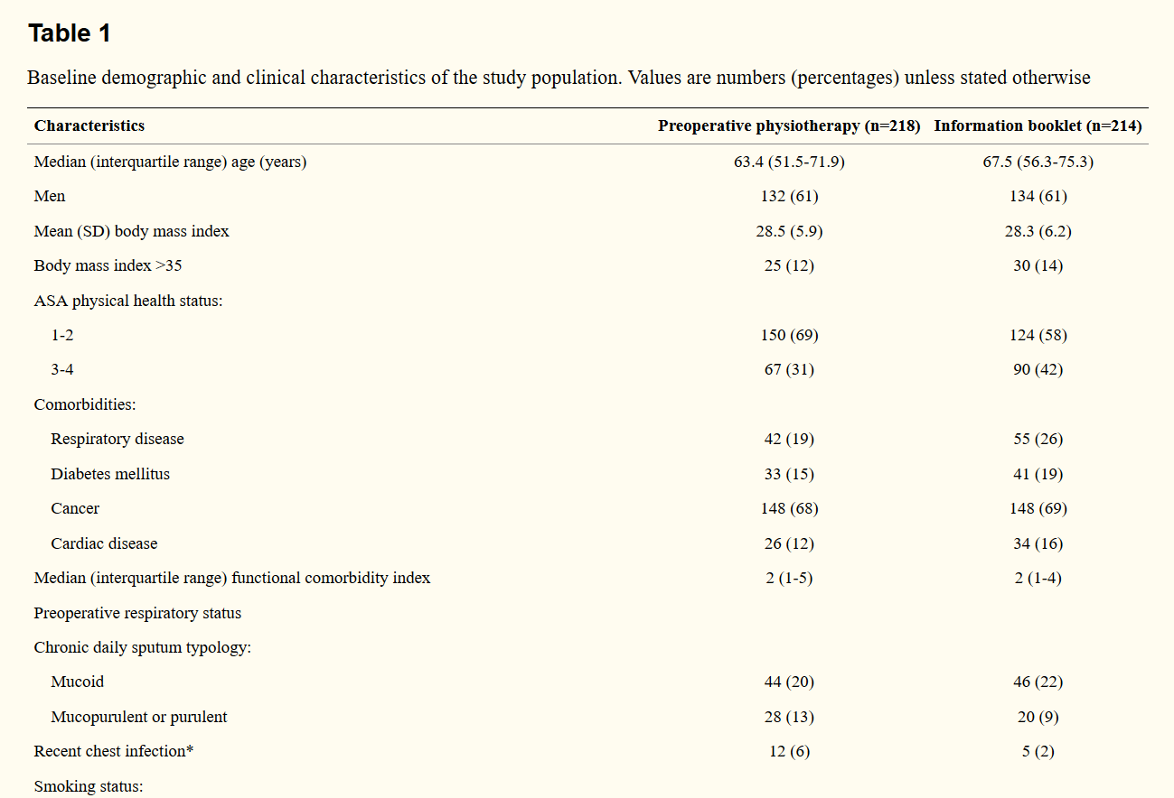
Results
Notes:
504 patients listed for elective upper abdominal surgery for eligibility
441 met the inclusion criteria and were randomly assigned to receive either an information booklet (n=219; control) or preoperative physiotherapy (n=222; intervention). Nine (2%) patients were withdrawn from the trial, leaving 432 (98%) included for primary analysis

Slide 24
Results
Notes:
504 patients listed for elective upper abdominal surgery for eligibility
441 met the inclusion criteria and were randomly assigned to receive either an information booklet (n=219; control) or preoperative physiotherapy (n=222; intervention). Nine (2%) patients were withdrawn from the trial, leaving 432 (98%) included for primary analysis

Slide 25
Results
Notes:
504 patients listed for elective upper abdominal surgery for eligibility
441 met the inclusion criteria and were randomly assigned to receive either an information booklet (n=219; control) or preoperative physiotherapy (n=222; intervention). Nine (2%) patients were withdrawn from the trial, leaving 432 (98%) included for primary analysis

Slide 26
Results
Notes:
504 patients listed for elective upper abdominal surgery for eligibility
441 met the inclusion criteria and were randomly assigned to receive either an information booklet (n=219; control) or preoperative physiotherapy (n=222; intervention). Nine (2%) patients were withdrawn from the trial, leaving 432 (98%) included for primary analysis

Slide 27
Results
Notes:
504 patients listed for elective upper abdominal surgery for eligibility
441 met the inclusion criteria and were randomly assigned to receive either an information booklet (n=219; control) or preoperative physiotherapy (n=222; intervention). Nine (2%) patients were withdrawn from the trial, leaving 432 (98%) included for primary analysis

Slide 28
Results
Notes:
504 patients listed for elective upper abdominal surgery for eligibility
441 met the inclusion criteria and were randomly assigned to receive either an information booklet (n=219; control) or preoperative physiotherapy (n=222; intervention). Nine (2%) patients were withdrawn from the trial, leaving 432 (98%) included for primary analysis

Slide 29
Results
Notes:
504 patients listed for elective upper abdominal surgery for eligibility
441 met the inclusion criteria and were randomly assigned to receive either an information booklet (n=219; control) or preoperative physiotherapy (n=222; intervention). Nine (2%) patients were withdrawn from the trial, leaving 432 (98%) included for primary analysis

Slide 30
Results
Notes:
504 patients listed for elective upper abdominal surgery for eligibility
441 met the inclusion criteria and were randomly assigned to receive either an information booklet (n=219; control) or preoperative physiotherapy (n=222; intervention). Nine (2%) patients were withdrawn from the trial, leaving 432 (98%) included for primary analysis

Slide 31
Results
Sensitivity analysis of subgroup effects on incidence of postoperative pulmonary complications (PPCs). Data are adjusted for age, respiratory comorbidity, and upper gastrointestinal surgery

Slide 32
Results
Sensitivity analysis of subgroup effects on hospital length of stay. Data are adjusted for age, respiratory comorbidity, and upper gastrointestinal surgery. PPC=postoperative pulmonary complication

Slide 33
Results
Sensitivity analysis of subgroup effects on 12 month all cause mortality. Data are adjusted for age, respiratory comorbidity, and upper gastrointestinal surgery. PPC=postoperative pulmonary complication

Slide 34
Discussion
Preoperative physiotherapy education and training session provided within six weeks of surgery halved the incidence of PPCs, including hospital acquired pneumonia after major upper abdominal surgery
This association was stronger in patients having colorectal surgery, those younger than 65 years, men, or where an experienced physiotherapist provided the education

Slide 35
Discussion
Hypothesis of effect
Postoperative breathing exercises performed by patients might reverse atelectasis
breathing exercises postoperatively appear less effective in reducing PPCs compared with preoperative interventions

Slide 36
Discussion
Hypothesis of effect
Timing of initiation could be critical
Intervention patients reported that preoperative physiotherapy education was memorable and engaging
Notes:
.Breathing exercises during the first 24 hours after surgery could prevent mild atelectasis extending to severe atelectasis

Slide 37
Discussion
Strengths of the trial
This trial included most types of upper gastrointestinal, colorectal, and renal procedures
88% of eligible patients were entered into the trial, with a 98% follow-up rate
Variety of public hospitals in developed countries - a small rural hospital
- a medium sized regional tertiary referral hospital
- a large major metropolitan university affiliated hospital

Slide 38
Discussion
Strengths of the trial
It is representative of the heterogeneous population having upper abdominal surgery
Varying grades of experience physiotherapists

Slide 39
Discussion
Strengths of the trial
This study recorded most known perioperative confounders, including preoperative functional status, intraoperative fluid administered, transfusions, ventilation strategies, and postoperative analgesia and antibiotic management and adjusted the results for baseline imbalances in variables known to influence PPCs

Slide 40
Discussion
Implications of findings
The most plausible reason for PPC reduction in trial is that the participants performed the breathing exercises as taught preoperatively

Slide 41
Discussion
Implications of findings
This cannot be proved in this study as we opted not to measure postoperative performance of breathing exercises
Measuring such performance could have resulted in a Hawthorne effect
Notes:
by artificially reminding patients to adhere to the prescribed breathing exercises

Slide 42
Discussion
Implications of findings
Measure of compliance
A sample of 29 patients was interviewed on the fifth postoperative day
94% of intervention participants remembering the breathing exercises
15% in those who received the booklet alone
Notes:
by artificially reminding patients to adhere to the prescribed breathing exercises

Slide 43
Discussion
Implications of findings
Early ambulation is also espoused as a possible intervention to prevent PPCs ,although this is not supported at systematic review level
This study suggest early ambulation to improve functional recovery and respiratory therapy to prevent PPCs
Notes:
by artificially reminding patients to adhere to the prescribed breathing exercises

Slide 44
Discussion
Implications of findings
Observational studies associate PPC incidence with increased hospital length of stay
In this study, a statistically significant reduction in length of stay was not detected in the overall population
Notes:
by artificially reminding patients to adhere to the prescribed breathing exercises

Slide 45
Discussion
Implications of findings
Possible explanations for this apparent paradox are that previously reported associative data between PPCs and length of stay is unadjusted for other factors that may influence both outcomes
Hospital stay is an outcome with complex multifactorial reasons for determination, and after abdominal surgery the standard deviation is wide
Notes:
This suggests that our length of stay findings may be limited by sample size and heterogeneous response rates rather than by a lack of effect from the intervention. Similarly, point estimates across almost all other secondary outcomes in our trial favoured the intervention group, with sensitivity analyses strengthening these relations further. Subgroups with the greatest reduction in PPCs had a consistent signal towards improved secondary outcomes favouring the intervention group.

Slide 46
Discussion
Implications of findings
The study has repeated the reported association between PPCs and in-hospital and 30 day mortality
It is also the first to find a signal of improved survival attributable to an intervention that reduces the incidence of PPCs, although considering the low event rates
Notes:
our study was not adequately powered, nor was it intended to, mortality being an exploratory secondary outcome

Slide 47
Discussion
Limitations
The results were adjusted to control for prespecified confounders imbalanced at baseline
However, this trial could have been further improved by using stratified randomisation according to known confounders—for example, surgical category and respiratory comorbidity
Notes:
our study was not adequately powered, nor was it intended to, mortality being an exploratory secondary outcome

Slide 48
Discussion
Limitations
Several aspects of our trial also limit generalisability
We excluded non-English speakers and only conducted our trial in developed Western countries
Notes:
It cannot be extrapolated that preoperative education would be effective with the use of interpreters, in a different social-cultural context, through different modes such as visual recordings or group sessions, or with health professionals other than physiotherapists.

Slide 49
Discussion
Limitations
At the New Zealand site, the reduction in PPCs was less than at Australian sites
It is possible that this was due to the difference in experience level of the preoperative physiotherapists
Notes:
It cannot be extrapolated that preoperative education would be effective with the use of interpreters, in a different social-cultural context, through different modes such as visual recordings or group sessions, or with health professionals other than physiotherapists.

Slide 50
Discussion
Conclusions
The trial provides strong evidence that preoperative education and training delivered within six weeks of open upper abdominal surgery by a physiotherapist reduces the incidence of PPCs

Slide 51
Discussion
Conclusions
Format of preoperative physiotherapy education and training was a single 30 minute intervention
This service could be considered for all patients awaiting upper abdominal surgery

Slide 52
Critical Appraisal
Does this study address a clear question?

Slide 53
Critical Appraisal
Are the results of this single trial valid?
Notes:
คิดตามสิ่งที่เราตั้งใจจะให้เขาทำตั้งแต่แรก ก็คือไม่ว่าคุณจะเอายากลับไปกินหรือไม่กิน เราก็จะถือว่าคุณอยู่ในกลุ่มยา เรียกว่าแบบ intention-to-treat
ข้อที่ดีกว่าเป็นอย่างมากของแบบที่สองนี้คือว่ามันยังรักษาความที่มันเกลี่ย ลักษณะที่เรา random ไว้ตั้งแต่แรกไว้ด้วยครับ ดังนั้นหากไม่มี intention to treat แล้วจริงๆ ก็ไม่รู้ว่าจะ randomize ไปทำไม ทำให้ขาดความน่าเชื่อถือไปเป็นอย่างมากครับ ซึ่งโดยส่วนใหญ่เดี๋ยวนี้ผู้วิจัยก็รู้กันและจะทำการวิเคราะห์แบบ intention-to-treat อยู่แล้ว ยกเว้นผู้วิจัยกลุ่มเล็กๆ ที่ยังไม่เคยรู้จัก EBM ครับ

Slide 54
Critical Appraisal
Are the results of this single trial valid?

Slide 55
Critical Appraisal
NNT = 7
-
Yes
Notes:
w

Slide 56
Critical Appraisal : RCT
Can I apply these valid, important results to my patients?

